Slide 1
Clinic Management System
Streamlining healthcare operations for better patient care
Abrar Hussain Syed
KSU ID: 001239386
HMI7540 - Healthcare Information Systems Development
Kennesaw State University
May 08th 2026
Notes:
AI-generated content may be incorrect. ---

Slide 2

Project Goal and Overview
Object-Oriented Programming Focus
The project emphasizes Python object-oriented programming by modeling patients and clinic as classes.
Patient Data Management
The system stores and manages patient details including personal info and health metrics with historical tracking.
Modular and Expandable Design
The program structure supports future expansion like visit records and report generation, maintaining clean separation.
Command-Line Interface Application
Implemented as a CLI application with a main function entry point, following Python best practices.
Notes:
--- This slide references information from the following file: https://kennesawedu-my.sharepoint.com/personal/asyed37_students_kennesaw_edu/Documents/Microsoft%20Copilot%20Chat%20Files/project.py This project is a simple Clinic Management System implemented in Python, designed as a command-line interface (CLI) application. The main goal of the project was to practice and demonstrate core Python programming concepts, with a strong emphasis on object-oriented programming (OOP). Rather than relying on scattered variables or procedural code, the project models real-world entities—such as patients and a clinic—using Python classes. This approach makes the program easier to understand, extend, and maintain. At a high level, the system is intended to store and manage basic patient information, including a patient’s name, date of birth, blood pressure, and weight. Each patient also maintains a history list, which is designed to support tracking changes in patient data over time. Although the current version of the project is minimal, the structure is intentionally set up to allow for future expansion, such as adding visit records, updating vitals, or generating reports. Another important goal of the project was to simulate how a real application might be organized. The program separates responsibilities clearly: individual patients are represented by their own class, while the clinic itself is managed by a separate system class. A main function serves as the entry point for the program, which is a standard Python practice and especially important for CLI-based applications. Overall, this project demonstrates an early but practical step toward building structured, real-world Python programs using classes and clean design principles.

Slide 3
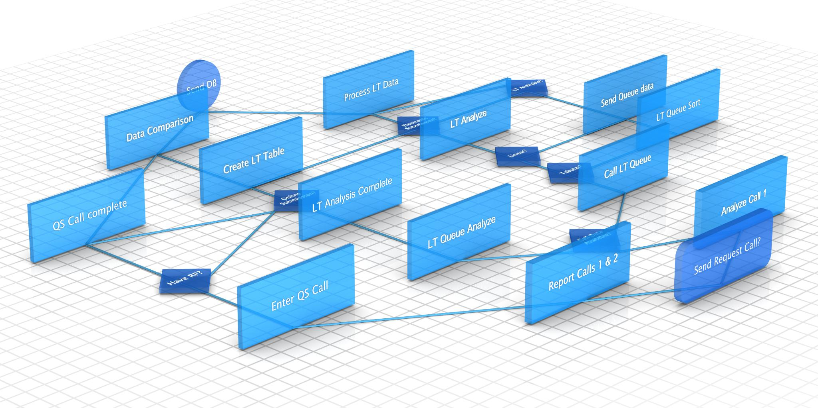
Code Structure and Design Decisions
Patient Class Structure
Patient class stores individual patient data including name, birthdate, blood pressure, weight, and history list.
ClinicSystem Class Role
ClinicSystem manages multiple patient objects, enabling scalable organization and modular code design.
Main Function Purpose
Main function initializes ClinicSystem and sets foundation for future CLI user interaction and program flow.
Design Principles
Design emphasizes clarity, modularity, readability, and extensibility.
Notes:
--- This slide references information from the following file: https://kennesawedu-my.sharepoint.com/personal/asyed37_students_kennesaw_edu/Documents/Microsoft%20Copilot%20Chat%20Files/project.py The code for this project is organized around two primary classes: the Patient class and the ClinicSystem class. The Patient class is responsible for storing all data related to an individual patient. Its constructor initializes attributes such as name, date of birth, blood pressure, and weight. In addition, a history list is created for each patient, which is intended to store past records or changes over time. This design choice reflects how medical data is often cumulative and emphasizes the benefit of using lists within objects to manage related data. The ClinicSystem class is designed to act as a container and manager for multiple patients. It maintains a collection of patient objects, allowing the clinic to scale beyond a single individual. While the current implementation is basic, the existence of this class establishes a clear separation of concerns: patients store their own data, while the clinic system is responsible for organizing and managing them. This separation makes the code more modular and easier to expand later. The main() function serves as the program’s entry point and is where the clinic system is instantiated. This follows common Python conventions and allows the file to be run directly as a script. Even though the CLI functionality is not fully implemented yet, the structure is in place for adding menus, user input, and program flow control. Overall, the design decisions focus on clarity, readability, and future extensibility rather than complexity, which is appropriate for a semester project at this stage.

Slide 4

What I Tried, Challenges, and Next Steps
Object-Oriented Programming Practice
Shifted from procedural to object-oriented design by grouping data and behavior into Python classes.
Design for Future Expansion
Added expandable features like a history list to prepare for evolving patient data in the system.
Challenges Faced
Encountered syntax errors and indentation problems which improved understanding of Python’s structure.
Next Development Steps
Plan to implement full ClinicSystem functionality including user menus and input validation.
Notes:
--- This slide references information from the following file: https://kennesawedu-my.sharepoint.com/personal/asyed37_students_kennesaw_edu/Documents/Microsoft%20Copilot%20Chat%20Files/project.py While working on this project, I focused on practicing how to define and use classes in Python, especially constructors and instance variables. One of the main things I tried was shifting from a procedural mindset to an object-oriented one. Instead of thinking in terms of individual variables and functions, I learned to group related data and behavior into classes, which made the code feel more organized and closer to a real application. I also experimented with designing the system in a way that could be expanded later. For example, adding a history list to the Patient class was an intentional choice, even though it is not fully used yet. This helped me think ahead about how patient data might evolve over time. However, I did face challenges along the way. Syntax errors, indentation issues, and properly defining class constructors were some of the most common problems. Debugging these issues helped reinforce my understanding of Python’s structure and error messages. If I were to continue developing this project, the next steps would include fixing any remaining syntax or indentation problems and fully implementing the ClinicSystem functionality. This would involve adding menu options to the CLI, allowing users to add new patients, update existing patient data, and view stored information. I would also like to add input validation to make the system more robust and user-friendly. Overall, this project helped solidify my understanding of Python basics and gave me confidence in working with object-oriented designs.

Slide 5

Special thanks to Prof. Nicolette Gordon for the guidance, support, and valuable feedback throughout this project.

